Slide 1
Lecture 7-8
MANAGING AND TRACKING THE SOFTWARE PROJECT

Slide 2
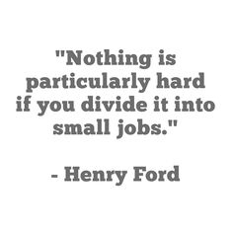

Slide 3
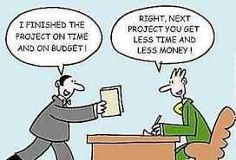

Slide 4
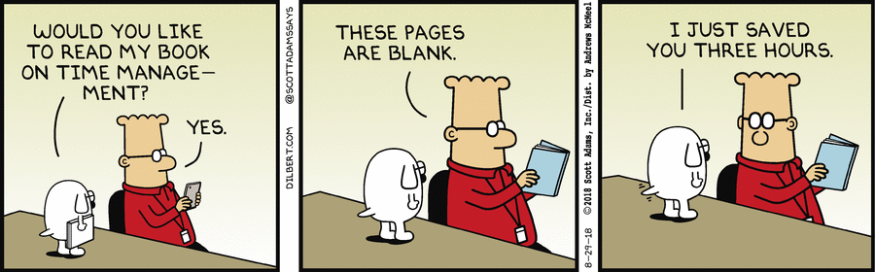

Slide 5
Questions from a Customer
Do you understand my problem and needs?
Can you design a system to solve my problems or satisfy my needs?
How long will it take to develop the system?
How much will it cost to develop the system?

Slide 6
Project Schedule
Describes the software-development cycle for a particular project by
enumerating the phases or stages of the project
breaking each phase into discrete tasks or activities to be completed
Portrays the interactions among the activities and estimates the times that each task or activity will take

Slide 7
Project Schedule (Contd.)
Understanding customer’s needs by listing all project deliverables
Documents
Demonstrations of function
Demonstrations of subsystems
Demonstrations of accuracy
Demonstrations of reliability, performance or security
Determining milestones and activities to produce the deliverables

Slide 8
Project Schedule (Contd.)
Activity: takes place over a period of time
Milestone: completion of an activity -- a particular point in time
Precursor: event or set of events that must occur in order for an activity to start
Duration: length of time needed to complete an activity
Due date: date by which an activity must be completed

Slide 9
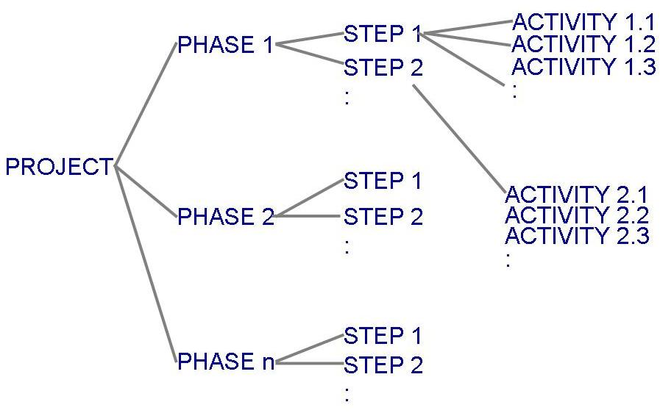
Project Schedule (Contd.)
Project development can be separated into a succession of phases which are composed of steps, which are composed of activities (Work Breakdown Structure)

Slide 10
Project Schedule (Contd.)
Table 3.1 shows the phases, steps and activities to build a house
landscaping phase
building the house phase
Table 3.2 lists milestones for building the house phase

Slide 11
Work Breakdown Structure (WBS) Phases, Steps, and Activities in Building a House

Slide 12
Milestones

Slide 13
WBS and Activity Graphs
Work breakdown structure depicts the project as a set of discrete pieces of work
Activity graphs depict the dependencies among activities
Nodes: project milestones
Lines: activities involved

Slide 14
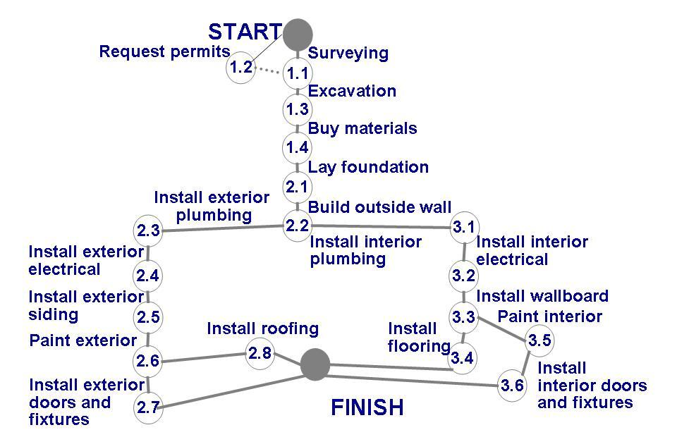
Activity graph for building a house
Identify precursor events
2.7, 2.8, 3.4, 3.6?
Does it tell us:
1.1 and 1.2 are precursor to Excavation activity
About completion of the project?
Duration of the project?
How can we modify the graph to estimate completion?
Mention duration of each activity?

Slide 15
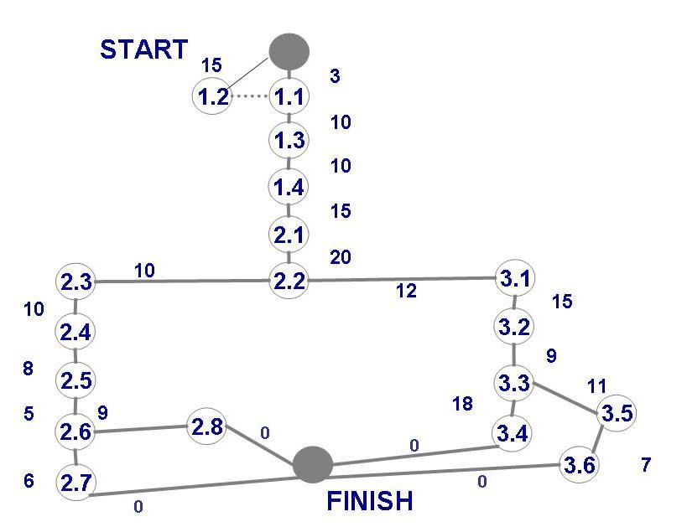

Slide 16
Estimating Completion
Adding estimated time in activity graph of each activity to be completed tells us more about the project's schedule

Slide 17
Estimating Completion Critical Path Method
Minimum amount of time required to complete a project
Reveals those activities that are most critical to completing the project on time
Real time (actual time): estimated amount of time required for the activity to be completed
Available time: amount of time available in the schedule for the activity's completion
Slack time: the difference between the available time and the real time for that activity

Slide 18
Estimating Completion Critical Path Method
Critical path: the slack at every line is zero
can be more than one in a project schedule
Slack time =
available time – real time
latest start time – earliest start time
Paths????
Longest Path???

Slide 20
Estimating Completion Critical Path Method

Slide 21
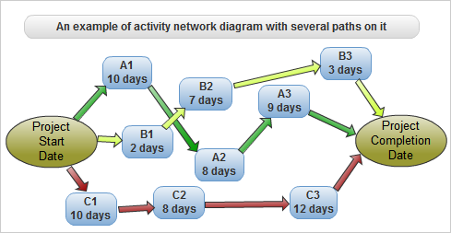

Slide 22
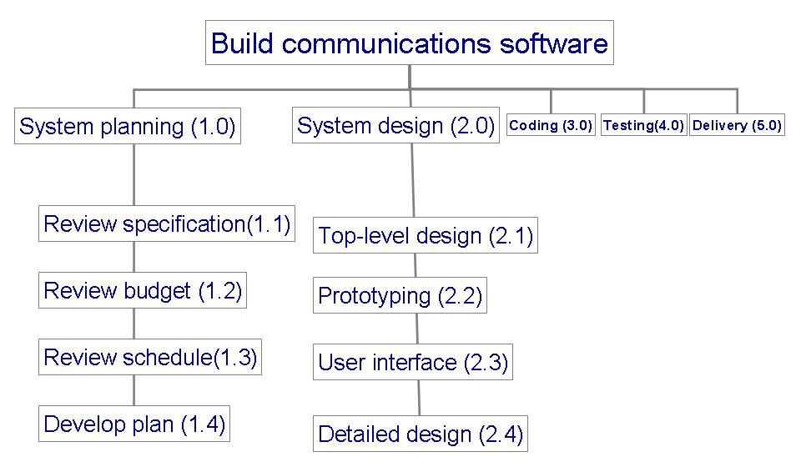
Example: to track progress of building a communication software
What is it?

Slide 23
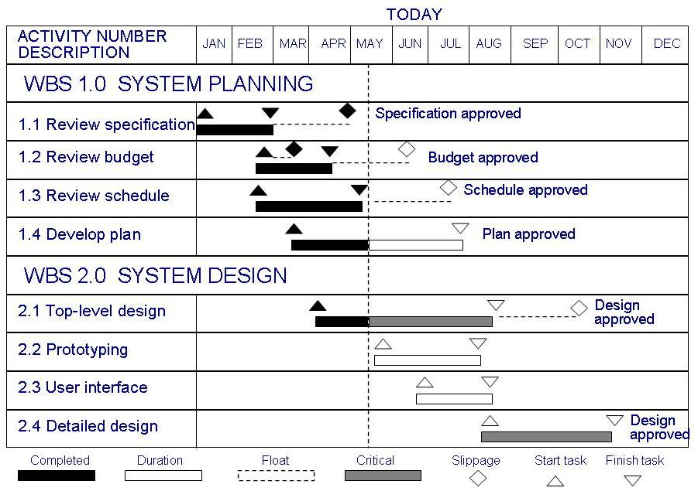
Tracking Progress Gantt Chart
Activities shown in parallel
helps understand which activities can be performed concurrently

Slide 24
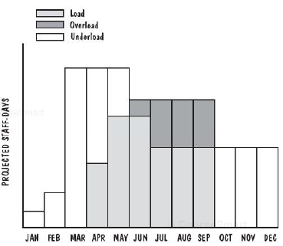
Tracking Resource Allocation Resource Histogram

Slide 26
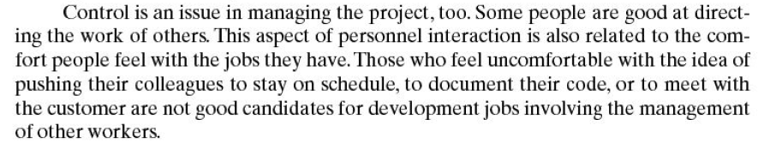

Slide 28
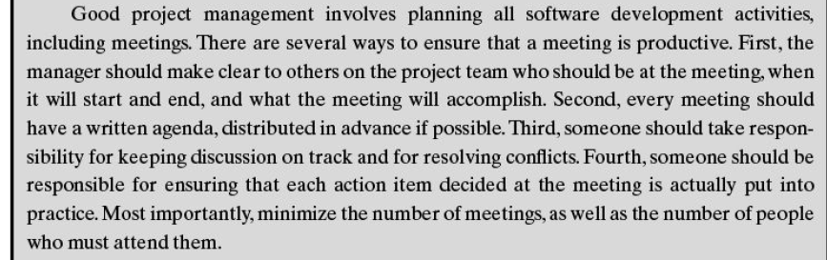

Slide 29
3.2 Project Personnel
Key activities requiring personnel
requirements analysis
system design
program design
program implementation
testing
training
maintenance
quality assurance
Assignment of staff depends on
project size
staff expertise
staff experience
Different responsibilities for different people

Slide 30
3.2 Project Personnel Choosing Personnel
Decide roles of project team members
Decide which kind of people do we need for each role
Select appropriate personnel for each role

Slide 31
3.2 Project Personnel Choosing Personnel
How do two people differ from each other:
Ability to perform work
Interest in work
Experience with
similar applications
similar tools, languages, or techniques
similar development environments
Training
Ability to communicate with others
Ability to share responsibility
Management skills

Slide 32
3.2 Project Personnel Communication
A project's progress is affected by
degree of communication
ability of individuals to communicate their ideas
Software failures can result from breakdown in communication and understanding

Slide 33
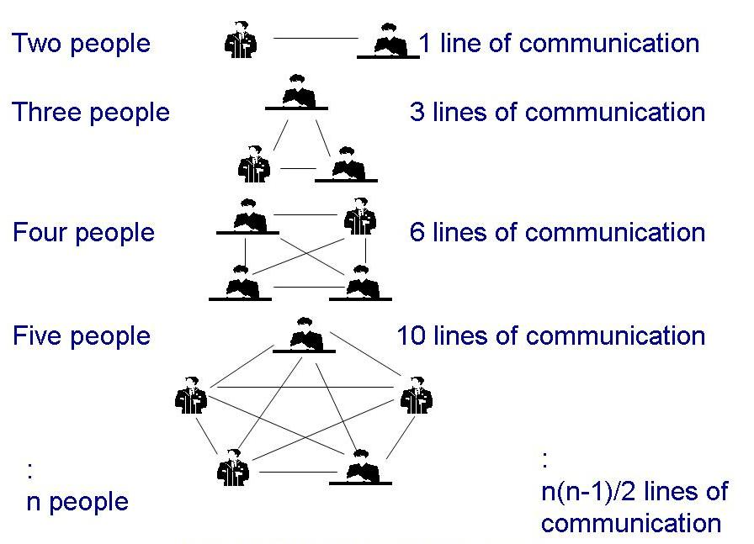
3.2 Project Personnel Communication (continued)
Line of communication can grow quickly
If there is n worker in project, then there are n(n-1)/2 pairs of communication

Slide 34
3.2 Project Personnel Sidebar 3.1 Make Meeting Enhance Project Progress
Common complains about meeting
the purpose is unclear
the attendees are unprepared
essential people are late or absent
the conversation veers away from its purpose
participants do not discuss, instead argue
decisions are never enacted afterward
Ways to ensure a productive meeting
clearly decide who should be in the meeting
develop an agenda
have someone who tracks the discussion
have someone who ensures follow-up actions

Slide 35
3.2 Project Personnel Work Styles
Extroverts: tell their thoughts
Introverts: ask for suggestions
Intuitives: base decisions on feelings
Rationals: base decisions on facts, options

Slide 36
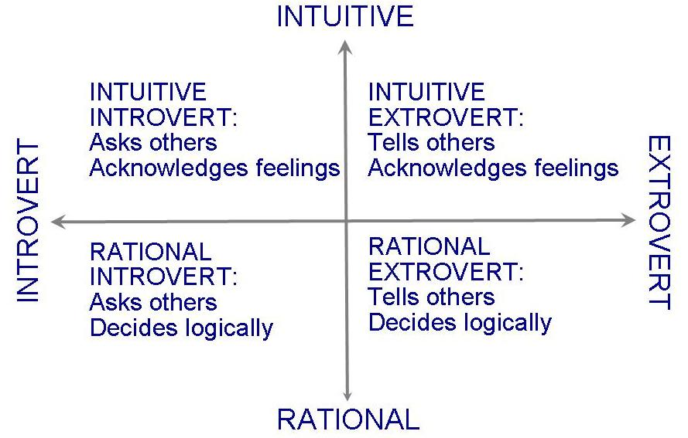
3.2 Project Personnel Work Styles (continued)
Horizontal axis: communication styles
Vertical axis: decision styles

Slide 38
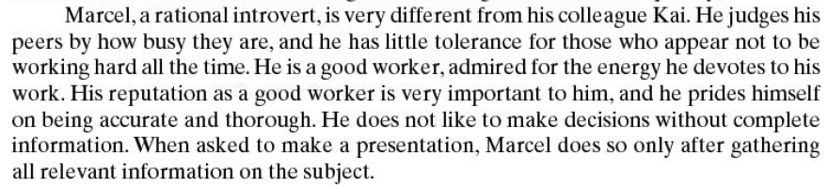

Slide 39
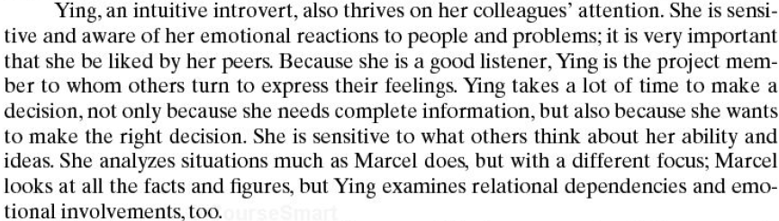

Slide 40
3.2 Project Personnel Work Styles (continued)
Work styles determine communication styles
Understanding workstyles
help to be flexible
give information based on other's priorities
Impacts interaction among customers, developers and users

Slide 41
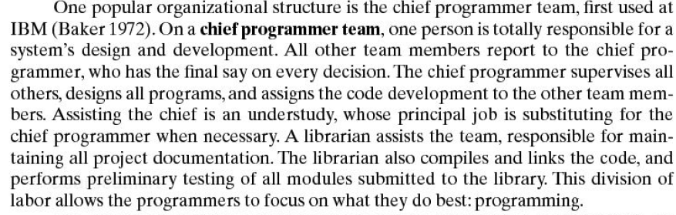

Slide 42
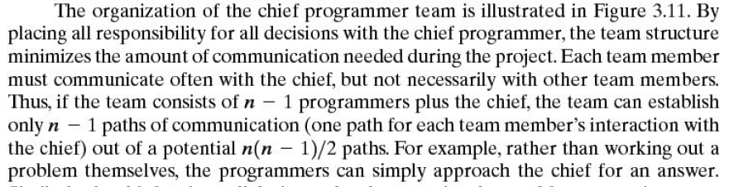

Slide 44
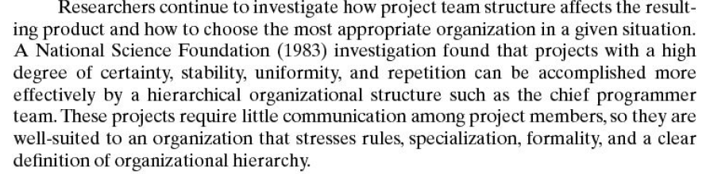

Slide 48
3.2 Project Personnel Project Organization
Depends on
backgrounds and work styles of team members
number of people on team
management styles of customers and developers
Examples:
Chief programmer team: one person totally responsible for a system's design and development
Egoless approach: hold everyone equally responsible

Slide 49
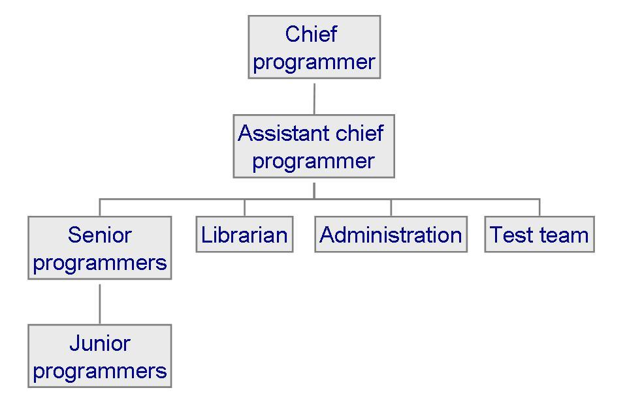
3.2 Project Personnel Project Organization: Chief Programmer Team
Each team member must communicate often with chief, but not necessarily with other team members

Slide 50
3.2 Project Personnel Project Organization (continued)
Characteristics of projects and the suggested organizational structure to address them

Slide 51
3.2 Project Personnel Sidebar 3.2 Structure vs. Creativity
Experiment by Sally Phillip examining two groups building a hotel
structured team: clearly defined responsibilities
unstructured team: no directions
The results are always the same
Structured teams finish a functional Days Inn
Unstructured teams build a creative, multistoried Taj Mahal and never complete
Good project management means finding a balance between structure and creativity

Slide 52
References
Pfleeger Book slides from UCF
Disclaimer!
A few slides have been reused from UCF slides for the SE course

Slide 53
Exercise
Recipe of making Chicken Biryani is given below:
In a large deep cooking pot, pour 2 tablespoons vegetable oil (or ghee) fry potatoes until brown, drain and reserve the potatoes. Add remaining 2 tablespoons oil to the pot and fry onion, garlic and ginger until onion is soft and golden. Add chili, pepper, turmeric, cumin, salt and the tomatoes. Fry, stirring constantly for 5 minutes. Add yogurt, mint, cardamom and cinnamon stick. Cover and cook over low heat, stirring occasionally until the tomatoes are cooked to a pulp. It may be necessary to add a little hot water if the mixture becomes too dry and starts to stick to the pan.
When the mixture is thick and smooth, add the chicken pieces and stir well to coat them with the spice mixture. Cover and cook over very low heat until the chicken is tender, approximately 35 to 45 minutes. There should only be a little very thick gravy left when chicken is finished cooking.
Soak the rice in warm water, then wash in cold until the water runs clear. Heat appropriate quantity of water in a separate large deep cooking pot. Add the washed rice in slightly hot water. Keep the heat on until the water boils. When most of the water dries out and the rice have been boiled (but there remain some water in the pot), the rice are ready to be mixed with the chicken gravy.
Mix the chicken gravy and the boiled rice layer by layer in a deep pot. When both have been put in the same pot, mix them gently. Cover the pot tightly, turn heat to very low and steam for 20 minutes. Do not lift lid or stir while cooking. After 20 minutes, biryani is ready to serve
Note: We have many cooking pans and many stoves available at the start of the project.
To Do:
Identify phases, steps, activities, and milestones of this project. After this identification provide the work breakdown structure. Also draw activity graph of the project. State your assumptions clearly.

Slide 54
Quiz on MCQs

Slide 55
Using scientific knowledge to design solution of a new problem is called
Scientific method
Engineering method
Commercial production method
Craft
All

Slide 56
The waterfall model is more suitable for ________
Scientific method
Engineering method
Commercial production method
Craft
All

Slide 57
The waterfall model with prototyping is more suitable for ________
Scientific method
Engineering method
Commercial production method
Craft
All

Slide 58
Method + tool =

Slide 59
Fault leads to _____

Slide 60
A software should not crash, this quality is called ______

Slide 61
A software should use minimum resources i.e. time and memory, this quality is called ______

Slide 62
A software should be able to run on all platforms, this quality is called ______

Slide 63
If the developer says , “you are not supposed to use it this way!” it means, the software lacks______

Slide 64
If the customers says , “It is not what I meant!” it means, the software lacks_ _____

Slide 65
We are going to build a project where fingers are crossed about our success.. What model should we use?

Slide 66
We are going to build a project where customer is not willing to pay until we deliver.. What model should we use?

Slide 67
We are going to build a project where we need customers live feedback and the project can be finished in 15 days…. What is best approach

